Slide 2
Antra SEP Program
TypeScript Fundamentals

Slide 3
Agenda
Introduction of TypeScript
JavaScript vs TypeScript
Variable
Enums
Arrays
Function
Interface
Classes
Generics
Namespaces

Slide 4
What is TypeScript
TypeScript is a strongly typed, object oriented, compiled language.
It contains all elements of the JavaScript.
It is a language designed for large-scale JavaScript application development, which can be executed on any browser, any Host, and any Operating System.
TypeScript is a typed superset of JavaScript compiled to JavaScript. In other words, TypeScript is JavaScript plus some additional features.

Slide 5
History of TypeScript
In 2010, Anders Hejlsberg, a core member of the development team of C# language, started working on TypeScript at Microsoft.
The first version of TypeScript was released to the public in the month of 1st October 2012 and was labeled as version 0.8.
Now, it is maintained by Microsoft under the Apache 2 license. The latest version of Typescript is TypeScript 4.1, which was released to the public on Nov 2020.

Slide 6
Features in TypeScript
Object Oriented Language
Support JavaScript Libraries
JavaScript is TypeScript
TypeScript is a superset of JavaScript
TypeScript is Portable
DOM Manipulation

Slide 7
Why use TypeScript
TypeScript supports Static typing, Strongly type, Modules, Optional Parameters, etc.
TypeScript supports object-oriented programming features such as classes, interfaces, inheritance, generics, etc.
TypeScript provides the error-checking feature at compilation time. It will compile the code, and if any error found, then it highlighted the mistakes before the script is run.
TypeScript supports all JavaScript libraries because it is the superset of JavaScript.

Slide 8
Why use TypeScript
TypeScript support reusability because of the inheritance.
TypeScript make app development quick and easy as possible, and the tooling support of TypeScript gives us autocompletion, type checking, and source documentation.
TypeScript has a definition file with .d.ts extension to provide a definition for external JavaScript libraries.
TypeScript supports the latest JavaScript features, including ECMAScript 2015.
TypeScript gives all the benefits of ES6 plus more productivity.
Developers can save a lot of time with TypeScript.

Slide 9
JavaScript VS TypeScript
JavaScript | TypeScript
It doesn't support strongly typed or static typing. | It supports strongly typed or static typing feature.
Netscape developed it in 1995. | Anders Hejlsberg developed it in 2012.
JavaScript source file is in ".js" extension. | TypeScript source file is in ".ts" extension.
It is directly run on the browser. | It is not directly run on the browser.
It is just a scripting language. | It supports object-oriented programming concept like classes, interfaces, inheritance, generics, etc.
It doesn't support optional parameters. | It supports optional parameters.
JavaScript doesn't support modules. | TypeScript gives support for modules.
JavaScript doesn't support generics. | TypeScript supports generics.
It is interpreted language that's why it highlighted the errors at runtime. | It compiles the code and highlighted errors during the development time.

Slide 10
Component of TypeScript
Language − It comprises of the syntax, keywords, and type annotations.
The TypeScript Compiler − The TypeScript compiler (tsc) converts the instructions written in TypeScript to its JavaScript equivalent.
The TypeScript Language Service − The "Language Service" exposes an additional layer around the core compiler pipeline that are editor-like applications. The language service supports the common set of a typical editor operations like statement completions, signature help, code formatting and outlining, colorization, etc.
App.ts
tsc app.ts
App.js

Slide 11
TypeScript – Types
TypeScript Type
Static
Generic
Decorators
Built-in
User-Defined

Slide 12
TypeScript – Static Type
Static types mean "at compile time" or "without running a program." In a statically typed language, variables, parameters, and objects have types that the compiler knows at compile time. The compiler used this information to perform the type checking.
Built-in Type
Number
Void
String
Null
Boolean

Slide 13

TypeScript – Any Type
It is the "super type" of all data type in TypeScript. It is used to represents any JavaScript value. It allows us to opt-in and opt-out of type-checking during compilation. If a variable cannot be represented in any of the basic data types, then it can be declared using "Any" data type. Any type is useful when we do not know about the type of value, and we want to skip the type-checking on compile time.
Syntax: let identifier: any = value;
Example:

Slide 14
TypeScript – User Defined Data type
User Defined Type
Class
Enum
Array
Interface
Functions
Touple

Slide 15
TypeScript – Variables
A variable is the storage location, which is used to store value/information to be referenced and used by programs. It acts as a container for value in code and must be declared before the use. We can declare a variable by using the var keyword. In TypeScript, the variable follows the same naming rule as of JavaScript variable declaration. These rules are-
The variable name must be an alphabet or numeric digits.
The variable name cannot start with digits.
The variable name cannot contain spaces and special character, except the underscore(_) and the dollar($) sign.
In ES6, we can define variables using let and const keyword. These variables have similar syntax for variable declaration and initialization but differ in scope and usage. In TypeScript, there is always recommended to define a variable using let keyword because it provides the type safety.

Slide 16
TypeScript – Variable
Variable Declaration
We can declare a variable in one of the four ways:
1. Declare type and value in a single statement
var [identifier] : [type-annotation] = value;
2. Declare type without value. Then the variable will be set to undefined.
var [identifier] : [type-annotation];
3. Declare its value without type. Then the variable will be set to any.
var [identifier] = value;
4. Declare without value and type. Then the variable will be set to any and initialized with undefined.
var [identifier];

Slide 17

TypeScript – Variable
let declarations
The let keyword is similar to the var keyword. The var declaration has some problems in solving programs, so ES6 introduced let keyword to declare a variable in TypeScript and JavaScript. The let keyword has some restriction in scoping in comparison of the var keyword.
The let keyword can enhance our code readability and decreases the chance of programming error.
The let statement are written as same syntax as the var statement:

Slide 18
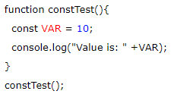
TypeScript – Variable
Const Declaration
Variables can be declared using const similar to var or let declarations. The const makes a variable a constant where its value cannot be changed. Const variables have the same scoping rules as let variables.
Example:
Output:

Slide 19
let vs var keyword
var | let
The var keyword was introduced with JavaScript. | The let keyword was added in ES6 (ES 2015) of JS.
It has global scope. | It is limited to block scope.
It can be declared globally and can be accessed globally. | It declared globally but cannot be accessed globally.
Variable declared with var keyword can be re-declared and updated in the same scope. Example: function varGreeter() { var a = 10; var a = 20; //a is replaced console.log(a); } varGreeter(); | Variable declared with let keyword can be updated but not re-declared. Example: function varGreeter() { let a = 10; let a = 20; //SyntaxError: //Identifier 'a' has already been declared console.log(a); } varGreeter();
It is hoisted. Example: { console.log(c); // undefined. //Due to hoisting var c = 2; } | It is not hoisted. Example: { console.log(b); // ReferenceError: //b is not defined let b = 3; }

Slide 20
TypeScript – Enums
Enums stands for Enumerations.
Enums are a new data type supported in TypeScript. It is used to define the set of named constants, i.e., a collection of related values.
TypeScript supports both numeric and string-based enums. We can define the enums by using the enum keyword.

Slide 21
Why Enums
It makes it easy to change values in the future.
It reduces errors which are caused by transporting or mistyping a number.
It exists only during compilation time, so it does not allocate memory.
It saves runtime and compile-time with inline code in JavaScript.
It allows us to create constants that we can easily relate to the program.

Slide 22
TypeScript – Enums
There are three types on enums these are:
Numeric Enums
String Enums
Heterogenous Enums

Slide 23
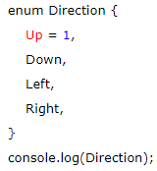
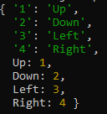
TypeScript – Numeric Enum
Numeric enums are number-based enums, which store values as numbers. It means we can assign the number to an instance of the enum.
Example: Output:
It is not necessary to assign sequential values to enum members always. We can provide any values to the enum members.

Slide 24
TypeScript – String Enums
String enums are a similar concept to numeric enums, except that the enum has some subtle runtime differences.
In a string enum, each enum values are constant-initialized with a string literal, or with another string enum member rather than numeric values.
String enums do not have auto-incrementing behavior.
The benefits of using this enum is that string enums provides better readability. If we were debugging a program, string enums allow us to give a meaningful and readable value when our code runs, independent of the name of the enum member itself.

Slide 25
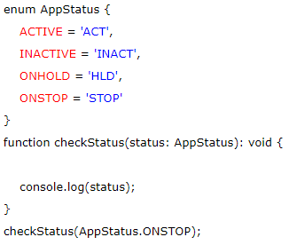
TypeScript – String Enums
Example: Output: Stop
In the above example, we have declared a string enum AppStatus with the same values as the numeric enum above. But string enum is different from numeric enum where string enum values are initialized with string literals. The difference between these enums is that the numeric enum values are auto-incremented, whereas string enum values need to be initialized individually.

Slide 26
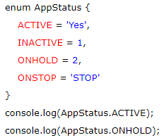

TypeScript – Heterogenous Enums
The heterogeneous enums are enums, which contains both string and numeric values. But it is advised that don't do this unless there is a need to take advantage of JavaScript runtime behavior.
Example: Output:

Slide 27
TypeScript – Arrays
An array is a homogenous collection of similar type of elements which have a contiguous memory location.
An array is a user-defined data type.
An array is a type of data structure where we store the elements of a similar data type. In an array, we can store only a fixed set of elements. We can also use it as an object.
The array is index-based storage, where the first element stored at index 0. The below structure helps to understand the structure of an array.

Slide 28
Characteristic of Arrays
An array stores elements which have the same data type.
Array elements stored in contiguous memory locations.
The storage of 2-D array elements is rowed by row in a contiguous memory location.
Array name represents the address of the starting element.
The size of an array should be initialized at the declaration time.
Array size should be a constant expression and not a variable.
We can retrieve array elements by specifying the element's corresponding index value.

Slide 29
Advantages and Disadvantages of Arrays
Advantages
Code Optimization: An array helps to make the code optimized, which increases the speed and performance of the program. It allows us to retrieve or sort the array data more efficiently.
Random access: It provides the ability to access any data of an array in constant time (independent of its position and size). Thus, we can get any data of an array located at any index position directly.
Disadvantages
Size Limit: An array allows us to store only the fixed number of elements. Once the array is declared, we cannot alter its size. Hence, if we want to insert more element than declared, it is not possible.

Slide 30
Array Declaration
1. Using square brackets.
let array_name[:datatype] = [val1,val2,valn..]
Example:
let fruits: string[] = ['Apple', 'Orange', 'Banana'];
2. Using a generic array type.
let array_name: Array<elementType> = [val1,val2,valn..]
Example:
let fruits: Array<string> = ['Apple', 'Orange', 'Banana'];

Slide 31
TypeScript – Types of Arrays
There are two types of arrays:
Single-Dimensional Arrays
Multi-Dimensional Arrays

Slide 32


TypeScript – Single Dimensional Arrays
A single-dimensional array is a type of linear array, which contains only one row for storing data. It has a single set of the square bracket ("[]"). We can access its elements either using row or column index.
Syntax: let array_name[:datatype];
Initialization: array_name = [val1,val2,valn..]
Example:
Output:

Slide 33
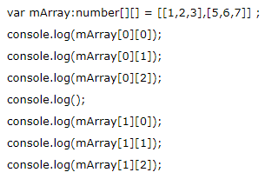
TypeScript – Multi-Dimensional Array
A multi-dimensional array is an array which contains one or more arrays. In the multi-dimensional array, data is stored in a row and column-based index (also known as matrix form). A two-dimensional array (2-D array) is the simplest form of a multi-dimensional array.
Syntax: let arr_name:datatype[][] = [ [a1,a2,a3], [b1,b2,b3] ];
Initialization: let arr_name:datatype[initial_array_index][referenced_array_index] = [ [val1,val2,val 3], [v1,v2,v3]];
Example: Output:

Slide 34
TypeScript – Array Methods
Methods | Description
concat() | It is used to joins two arrays and returns the combined result.
copyWithin() | It copies a sequence of an element within the array.
every() | It returns true if every element in the array satisfies the provided testing function.
fill() | It fills an array with a static value from the specified start to end index.
indexOf() | It returns the index of the matching element in the array, otherwise -1.
includes() | It is used to check whether the array contains a certain element or not.
Join() | It is used to joins all elements of an array into a string.
lastIndexOf() | It returns the last index of an element in the array.
Pop() | It is used to removes the last elements of the array.

Slide 35
TypeScript – Array Methods
Methods | Description
Push() | It is used to add new elements to the array.
reverse() | It is used to reverse the order of an element in the array.
Shift() | It is used to removes and returns the first element of an array.
slice() | It returns the section of an array in the new array.
sort() | It is used to sort the elements of an array.
splice() | It is used to add or remove the elements from an array.
toString() | It returns the string representation of an array.
unshift() | It is used to add one or more elements to the beginning of an array.

Slide 36
TypeScript – Function
Functions are the fundamental building block of any applications in JavaScript. It makes the code readable, maintainable, and reusable.
We can use it to build up layers of abstraction, information hiding.
In TypeScript, however, we have the concept of classes, namespaces, and modules, but functions still are an integral part in describing how to do things.
TypeScript also allows adding new capabilities to the standard JavaScript functions to make the code easier to work.

Slide 37
Advantages of Function
Code reusability: We can call a function several times without writing the same block of code again. The code reusability saves time and reduces the program size.
Less coding: Functions makes our program compact. So, we don't need to write many lines of code each time to perform a common task.
Easy to debug: It makes the programmer easy to locate and isolate faulty information.

Slide 38

TypeScript – Function Aspects
Function declaration: A function declaration tells the compiler about the function name, function parameters, and return type. The syntax of the function declaration is:
Function definition: It contains the actual statements which are going to executes. It specifies what and how a specific task would be done. The syntax of the function definition is:
Function call: We can call a function from anywhere in the program. The parameter/argument cannot differ in function calling and a function declaration. We must pass the same number of functions as it is declared in the function declaration. The syntax of the function call is:

Slide 39
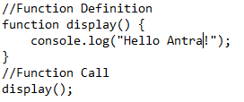

Function Creation
We can create a function in two ways. These are:
Named function
Anonymous function
Named function: When we declare and call a function by its given name, then this type of function is known as a named function.
Syntax: functionName( [arguments] ) { }
Example Output:

Slide 40
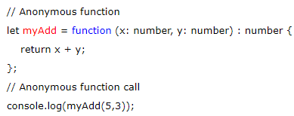

Anonymous Function
A function without a name is known as an anonymous function. These type of functions are dynamically declared at runtime. It is defined as an expression. We can store it in a variable, so it does not need function names. Like standard function, it also accepts inputs and returns outputs. We can invoke it by using the variable name, which contains function.
Syntax: let res = function( [arguments] ) { }
Example: Output:

Slide 41
Function Parameter
Parameters are the values or arguments that passed to a function. In TypeScript, the compiler accepts the same number and type of arguments as defined in the function signature. If the compiler does not match the same parameter as in the function signature, then it will give the compilation error.
Function parameter can be categories into the following:
Optional Parameter
Default Parameter
Rest Parameter

Slide 42
Optional Parameter
In JavaScript, we can call a function without passing any arguments. Hence, in a JavaScript function, the parameter is optional, and when we do this, each parameter value is undefined.
Unlike JavaScript, the TypeScript compiler will throw an error if we try to invoke a function without providing the exact number and types of parameters as declared in its function signature.
To overcome this problem, we can use optional parameters by using the question mark sign ('?'). It means that the parameters which may or may not receive a value can be appended with a "?" sign to mark them as optional. In below example, e_mail_id is marked as an optional parameter.

Slide 43
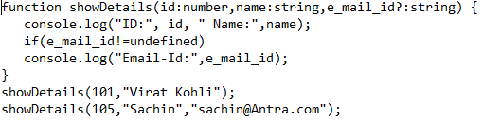
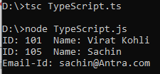
Optional Parameter – Example
Syntax: function function_name(parameter1[:type], parameter2[:type], parameter3 ? [:type]) { }
Example:
Output:

Slide 44
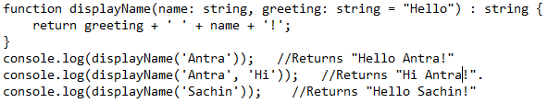
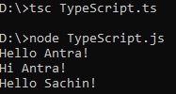
Default Parameter
Function parameters can also be assigned values by default. However, such parameters can also be explicitly passed values.
Syntax: function function_name(parameter1[:type], parameter2[:type] = default_value) { }
Example:
Output:

Slide 45
TypeScript – Arrow Functions
ES6 version of TypeScript provides an arrow function which is the shorthand syntax for defining the anonymous function, i.e., for function expressions.
We can call it fat arrow (because -> is a thin arrow and => is a "fat" arrow).
It is also called a Lambda function.
The arrow function has lexical scoping of "this" keyword.
Syntax:
The motivation for arrow function is:
When we don't need to keep typing function.
It lexically captures the meaning of this keyword.
It lexically captures the meaning of arguments.

Slide 46




Arrow Function – Example
Arrow Function with Parameter
Arrow function without Parameter

Slide 47
TypeScript - Interfaces
An Interface is a structure which acts as a contract in our application. It defines the syntax for classes to follow, means a class which implements an interface is bound to implement all its members. We cannot instantiate the interface, but it can be referenced by the class object that implements it. The TypeScript compiler uses interface for type-checking (also known as "duck typing" or "structural subtyping") whether the object has a specific structure or not.
The interface contains only the declaration of the methods and fields, but not the implementation. We cannot use it to build anything. It is inherited by a class, and the class which implements interface defines all members of the interface.

Slide 48
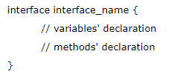
Interface Declaration
An interface is a keyword which is used to declare a TypeScript Interface.
An interface_name is the name of the interface.
An interface body contains variables and methods declarations.

Slide 49
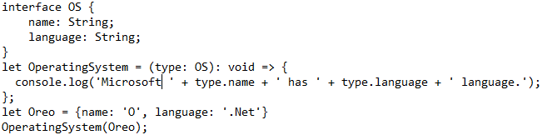

Interface – Example
In the above example, we have created an interface OS with properties name and language of string type. Next, we have defined a function, with one argument, which is the type of interface OS.
Now, compile the TS file into the JS which looks like the below output.

Slide 50
TypeScript – Classes
In object-oriented programming languages like C#, classes are the fundamental entities which are used to create reusable components. It is a group of objects which have common properties. In terms of OOPs, a class is a template or blueprint for creating objects. It is a logical entity.
A class definition can contain the following properties:
Fields: It is a variable declared in a class.
Methods: It represents an action for the object.
Constructors: It is responsible for initializing the object in memory.
Nested class and interface: It means a class can contain another class.

Slide 51

TypeScript – Classes
Syntax to declare a class
A class keyword is used to declare a class in TypeScript. We can create a class with the following syntax:

Slide 52
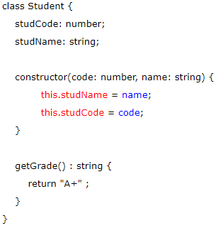
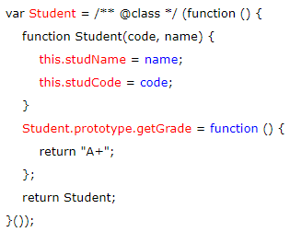
Classes – Example
Example:
The TypeScript compiler converts the above class in the following JavaScript code.
TypeScript code
JavaScript code

Slide 53

TypeScript – Classes
Creating an object class
A class creates an object by using the new keyword followed by the class name. The new keyword allocates memory for object creation at runtime. All objects get memory in heap memory area. We can create an object as below.
Syntax:
new keyword: it is used for instantiating the object in memory.
The right side of the expression invokes the constructor, which can pass values.
Example:

Slide 54
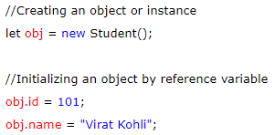
TypeScript – Classes
Object Initialization
Object initialization means storing of data into the object. There are three ways to initialize an object. These are:
By reference variable
Example:

Slide 55
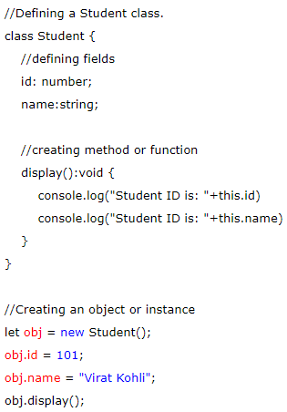

TypeScript – Classes
By Method
A method is similar to a function used to expose the behavior of an object.
Advantage of Method
Code Reusability
Code Optimization
Example:
Output:

Slide 56
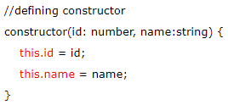
TypeScript – Classes
A constructor is used to initialize an object. In TypeScript, the constructor method is always defined with the name "constructor." In the constructor, we can access the member of a class by using this keyword.
Example:

Slide 57
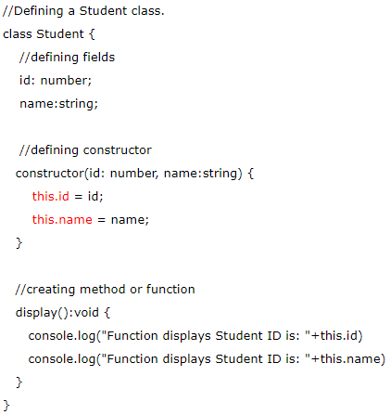
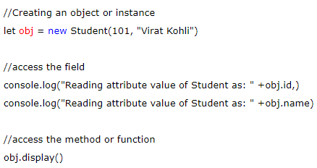
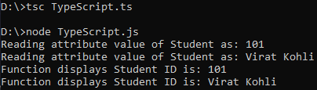
TypeScript – Classes
Example with constructor, method and object:

Slide 58
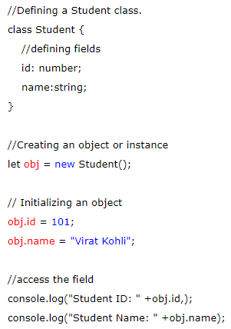

TypeScript – Classes
Example without constructor:
Output:

Slide 59
TypeScript – Generics
TypeScript Generics is a tool which provides a way to create reusable components. It creates a component that can work with a variety of data types rather than a single data type. Generics ensures that the program is flexible as well as scalable in the long term.
Generics provides type safety without compromising the performance, or productivity. TypeScript uses generics with the type variable which denotes types. The type of generic functions is just like non-generic functions, with the type parameters listed first, similarly, to function declarations.
In generics, we need to write a type parameter between the open (<) and close (>) brackets, which makes it strongly typed collections. Generics use a special kind of type variable <T> that denotes types. The generics collections contain only similar types of objects.
In TypeScript, we can create generic classes, generic functions, generic methods, and generic interfaces. TypeScript Generics is almost similar to C# generics.

Slide 60
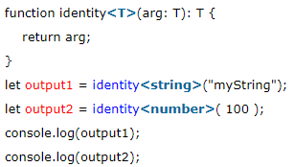
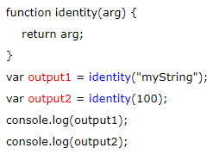

TypeScript – Generics
Example
When we compile the above file, it returns the corresponding JavaScript file as below.
Output:

Slide 61
TypeScript – Generics
Advantages of Generics
Type-safety: We can hold only a single type of objects in generics. It doesn't allow to store other objects.
Typecasting is not required: There is no need to typecast the object.
Compile-Time Checking: It is checked at compile time so the problem will not occur at runtime.

Slide 62
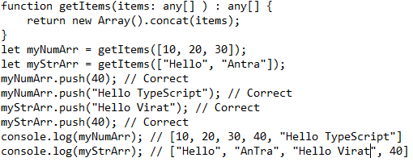

TypeScript – Generics
Why need Generics?
We can understand the need for generics by using the following example.
Output:

Slide 63
TypeScript – Generics
In the previous slide example, the getItems() function accepts an array which is of type any. The getItems() function creates a new array of type any, concatenates items to it and returns this new array. Since we have used any data type, we can pass any type of items to the function. But, this may not be the correct way to add items. We have to add numbers to number array and the strings to the string array, but we do not want to add numbers to the string array or vice-versa.
To solve this, TypeScript introduced generics. In generics, the type variable only accepts the particular type that the user provides at declaration time. It is also preserving the type checking information.

Slide 64
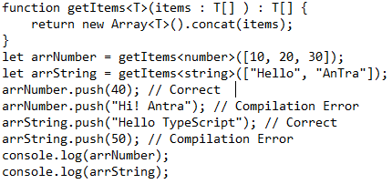

TypeScript – Generics
So, we can write the above function in generic function as below.
Output:

Slide 65
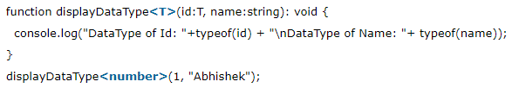

TypeScript – Generics
We can also use generic types with other non-generic types.
Output:

Slide 66
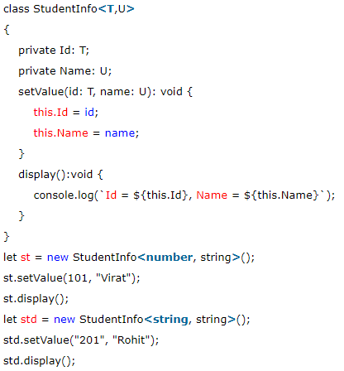

TypeScript – Generics Classes
TypeScript also supports generic classes. The generic type parameter is specified in angle brackets (<>) following the name of the class. A generic class can have generic fields or methods.
Output:

Slide 67
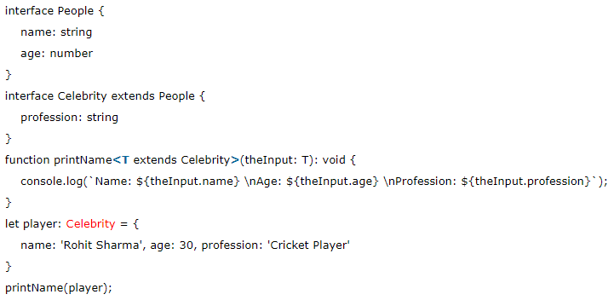
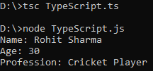
TypeScript – Generic Interface
The generic type can also be used with the interface.
Output

Slide 68
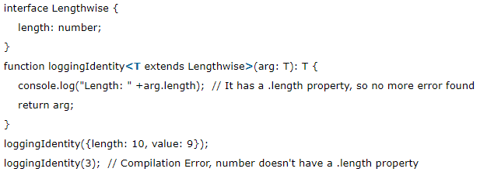

TypeScript – Generics Constraints
TypeScript Generics Types allows working with any and all data type. However, we can restrict it to certain types by using constraints. In the following example, we will create an interface that has a single .length property. We will use this interface, and the "extends" keyword to denote our constraint.

Slide 69
TypeScript - Namespaces
The namespace is a way which is used for logical grouping of functionalities. It encapsulates the features and objects that share common relationships. It allows us to organize our code in a much cleaner way.
A namespace is also known as internal modules. A namespace can also include interfaces, classes, functions, and variables to support a group of related functionalities.
Unlike JavaScript, namespaces are inbuilt into TypeScript. In JavaScript, the variables declarations go into the global scope. If the multiple JavaScript files are used in the same project, then there will be a possibility of confusing new users by overwriting them with a similar name. Hence, the use of TypeScript namespace removes the naming collisions.

Slide 70


TypeScript – Namespaces
Namespaces Declaration
We can create a namespace by using the namespace keyword followed by the namespace_name. All the interfaces, classes, functions, and variables can be defined in the curly braces{} by using the export keyword. The export keyword makes each component accessible to outside the namespaces. We can declare the namespace as below.
To access the interfaces, classes, functions, and variables in another namespace, we can use the following syntax.
If the namespace is in separate TypeScript file, then it must be referenced by using triple-slash (///) reference syntax.

Slide 71
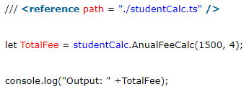
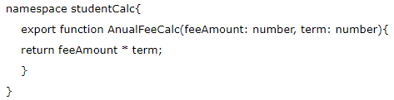
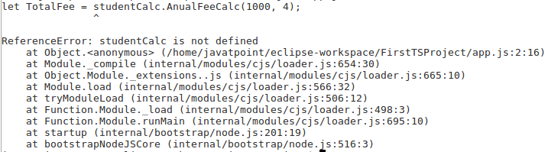

TypeScript – Namespaces
Example
Create a project and Declare files
NameSpace file: studentCalc
Compile and Execute Namespace
Main File: app.ts

Slide 72
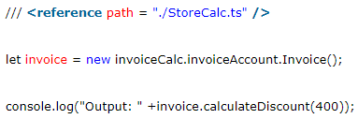
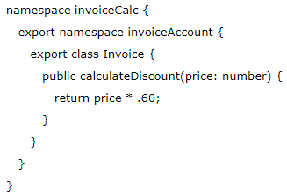
TypeScript - Namespaces
A namespace also allows us to define one namespace into another namespace. We can access the members of the nested namespace by using the dot(.) operator. The following example helps us to understand the nested namespace more clearly.
Example
Nested NameSpace file: StoreCalc
Main File: app.ts
Output: 240

Slide 73
Thank You

